Slide 1

BUas
Presented by Group 2 – Andrea Tosheva, Dominik Szewczyk, Rebecca Borski, Borislav Nachev
Notes:
Andrea

Slide 2







WHAT
is Natural Language processing?
How is it useful?
Smart assistants
Emotion
classification
Language
translation
Fake news
detection
Predictive
text
Digital
phone calls
Notes:
Andrea
What is natural language processing?
Natural language processing (NLP) is the ability of a computer program to understand the natural human languages whether it be written, spoken, or even scribbled. One of the primary goals of NLP is to achieve best comprehension of grammar, syntax, semantics, context, and pragmatics.
Why is it useful?
Smart assistants
Smart assistants like Apple’s Siri and Amazon’s Alexa recognize patterns in speech thanks to voice recognition, then infer meaning and provide a useful response
Language Translation
With the help of NLP, online translators can translate languages more accurately and present grammatically-correct results. Moreover, most translators implement toos which recognise the language based on the inputted text and translat it.
Predictive text refers to features like autocorrect and autocompletion.
Recordings of phone calls for training purposes. The recorded calls are used for the NLP systems to learn from and provide improved and personalized serviced.
Another usage of NLP is developing algorithms for fake news detection, by sentimental analysis, fact-checkinig, NER etc.
The last one here is emotion classification which leads us forward with the use case.

Slide 3


The problem to solve
Notes:
Andrea
content clssification tool for the purpose of emotion classification.

Slide 4
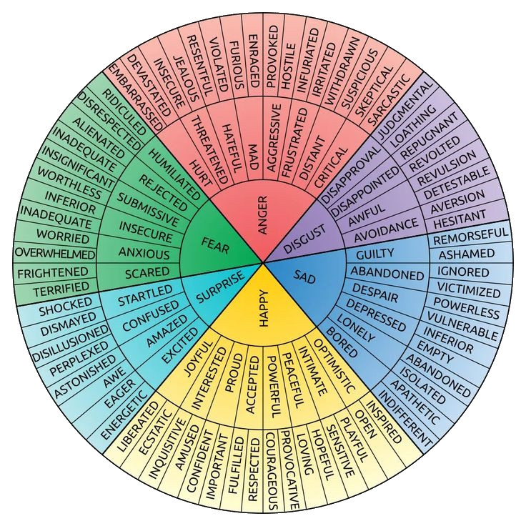

Emotion classification
Notes:
Andrea
Ekman and Friesen
Tool is able to tag content by the minute or fragment based on what is happening in that fragment.
So far the tagging has been done manually.

Slide 5

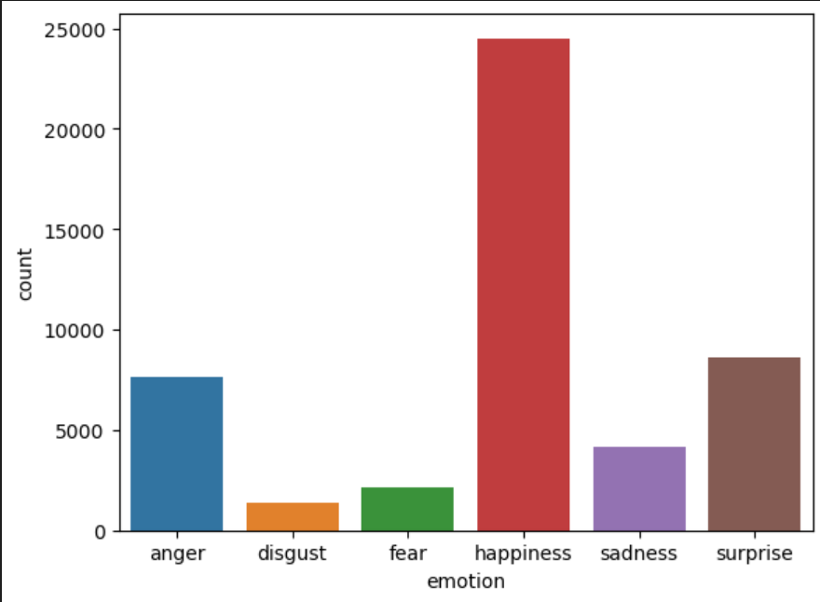
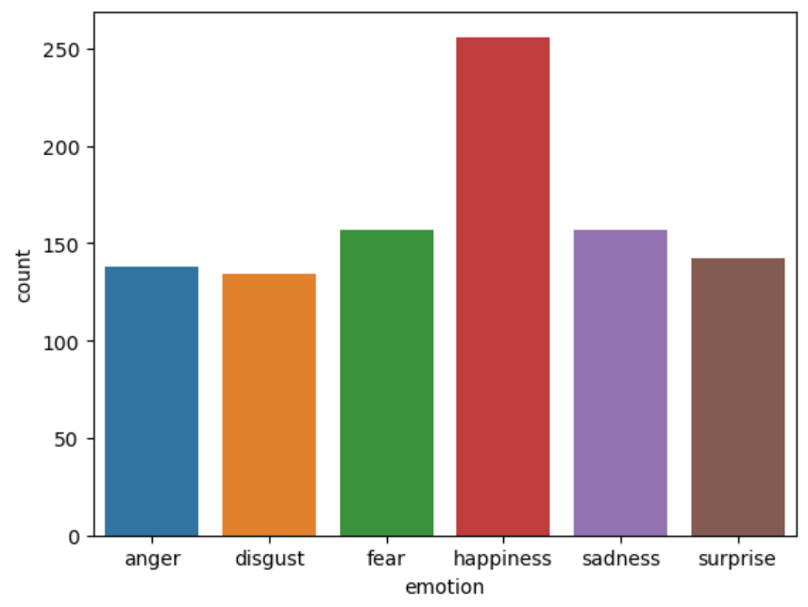
Dataset selection and EDA
MELD
Friends
Test Data
Training Data
OpenAI
Generated data
Data gained through a survey (annotated by students for 6 core emotions)
Daily Dialogue
GoEmotions
Use Case Data
Expeditie Robinson episodes and data from Banijay.
Notes:
Dominik

Slide 6

Preprocessing Feature engineering
Cleaning
BERT Tokenizer
Removal of unnecessary characters
Fixing apostrophes
Removing newline characters
Contextual Information Extraction
Subword-based Tokenization
Special Handling
Features
Term Frequency-Inverse Document Frequency (TF-IDF)
Named Entities
Part of Speech tagging (POS)
Sentiment
Notes:
Dominik

Slide 7





Models
F1 59%
Woks well with small datasets
Fastest model to train
Non-Context Based
F1 61%
Larger datasets lead to better results
Training time depends on the architecture
Multi-head
Attention
Context
Based
F1 89%
Requires a large amount of data
Slowest model to train
Notes:
Borislav

Slide 8
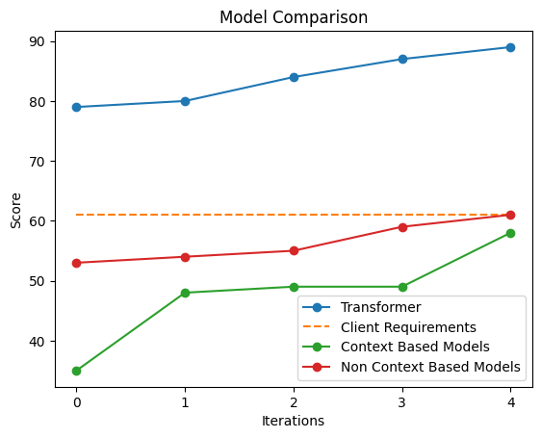
Submissions
Misleading validation accuracy
Generated data
Transformer models the client requirements.
Notes:
Borislav

Slide 9
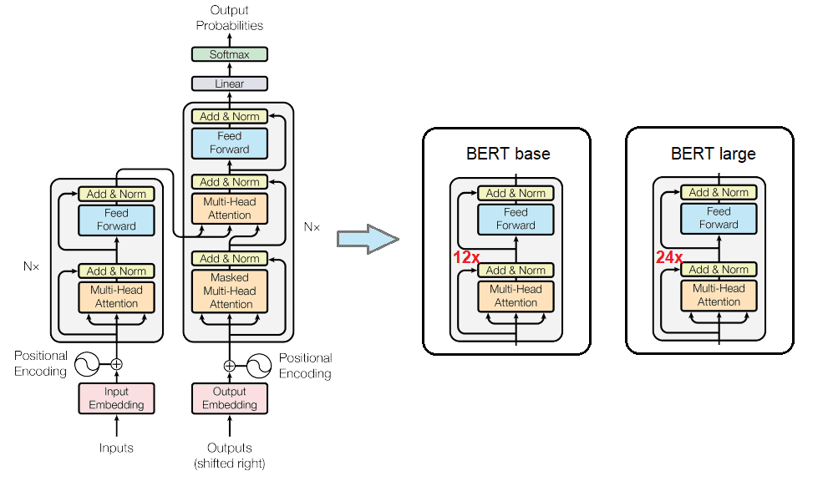


Why Bert Base?
Client requirements
Fine tunned = Accurate predictions
Performs better than the other transformers
Cased or uncased?
Notes:
Borislav

Slide 10
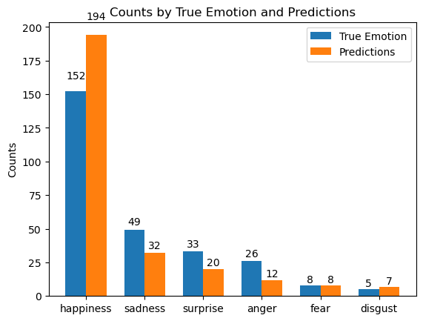
Performance
Accuracy alone is an unreliable metric, when classes have a higher count than others
might lead to biased evaluations
Accuracy: 0.5347
Recall: 0.5347
F1 Score: 0.4942
Recall = proportion of true positives among true positives + false negatives.
harmonic mean of precision and recall
F1 score is the most important metric
often used when there is an uneven class distribution
Trade-off between good precision and recall
Minimizing false positives = good precision
Notes:
All
what are the strengths and weaknesses of your models? What is the trade-off between good precision and recall, what is more important? Apply it to the use case of Expeditie Robinson.
the false positives and false negatives might be balanced out by true positives and true negatives
Causes:
One cause could be that while some emotions have higher false positives or false negatives, they are balanced by other emotions with fewer false positives or false negatives, causing the accuracy and recall scores to be the same.
Additionally, if one emotion has a significantly higher sample in the dataset and is well predicted by the model, it might influence the overall accuracy and recall to be the same.

Slide 11
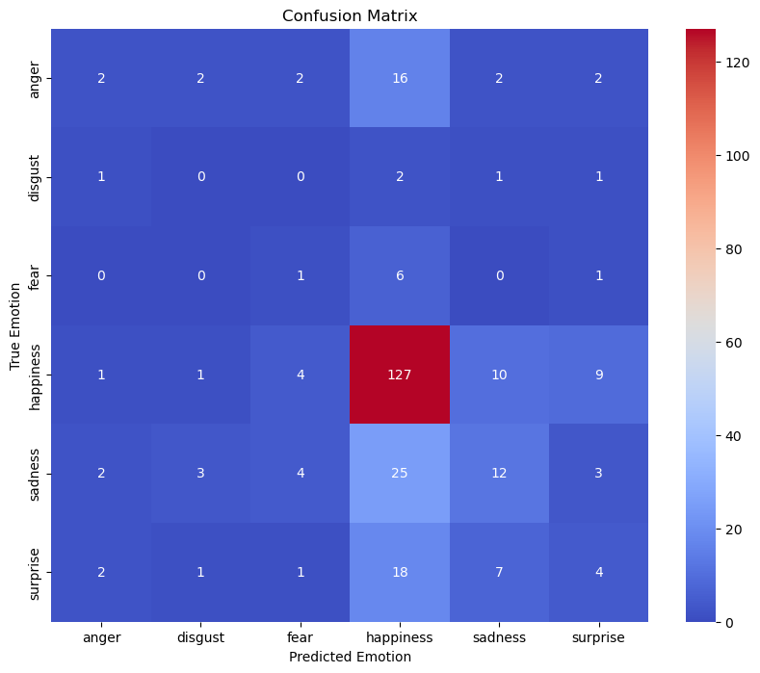






Error Analysis
Correct predictions
Happiness: 127
Disgust: 0
Anger: 2
Fear: 1
Sadness: 12
Surprise: 4
Notes:
Rebecca
Strengths and weaknesses
Significantly less fragments for other emotions which makes it less indicative for them

Slide 12
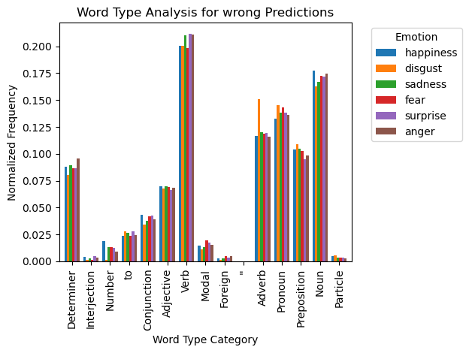
Error Analysis
Word-type Analysis
No significant difference
Notes:
Rebecca

Slide 13
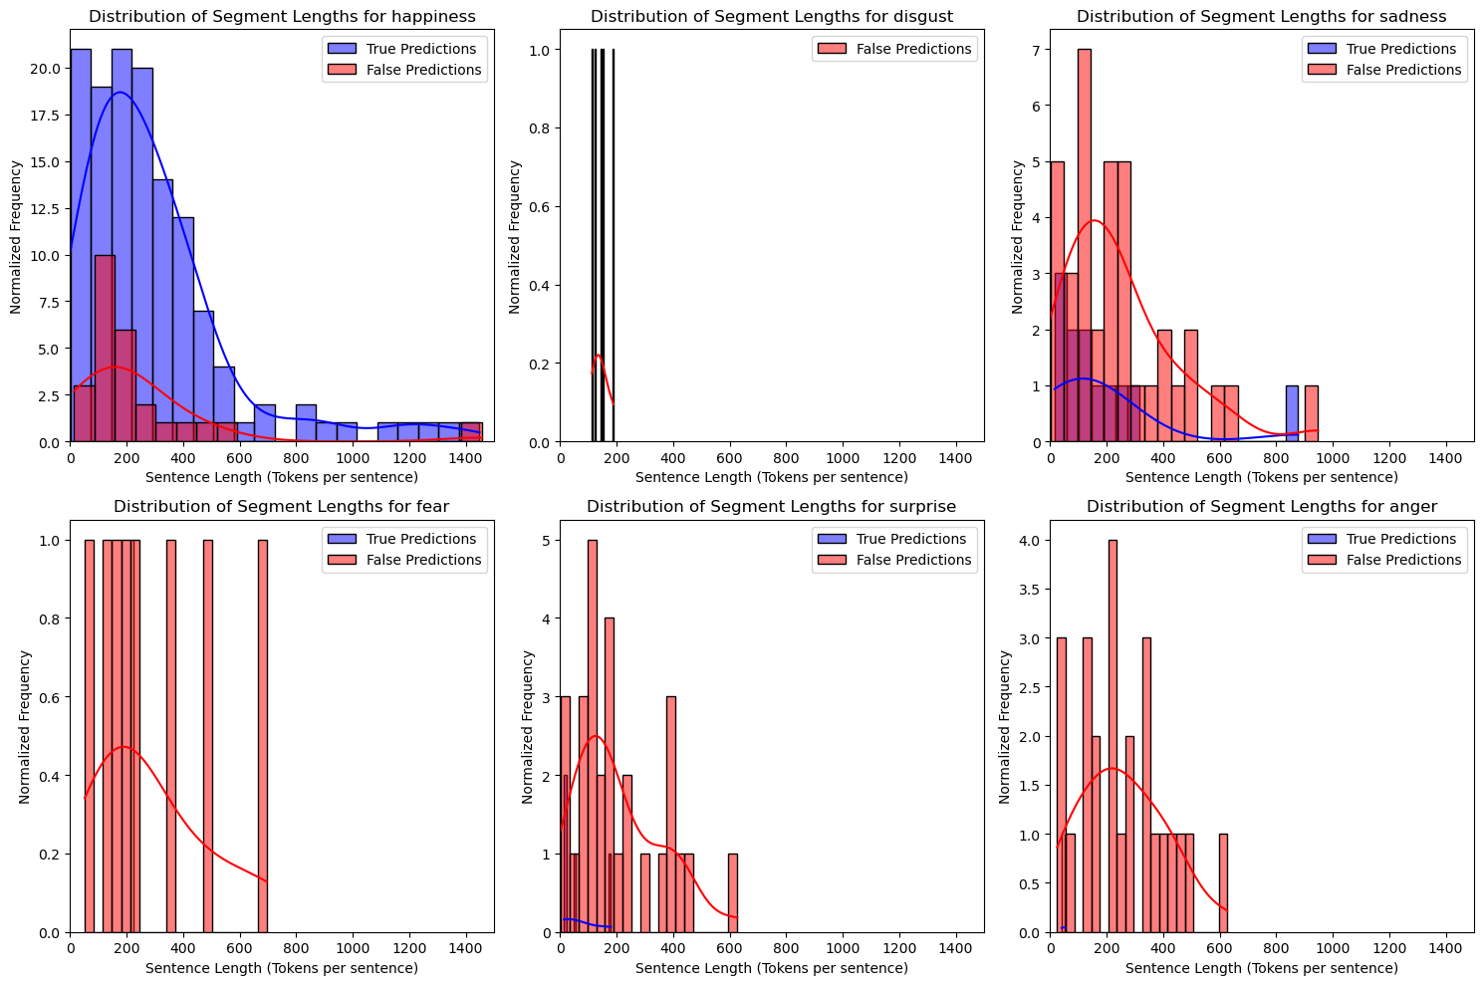
Error Analysis
Fragment Length Analysis
Transcription had no reliable punctuation
No significant difference
Notes:
Rebecca

Slide 14
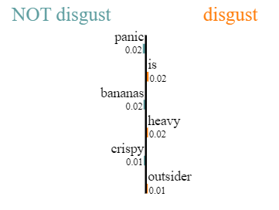
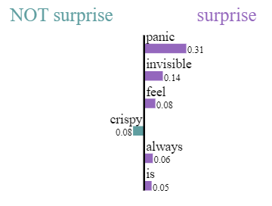
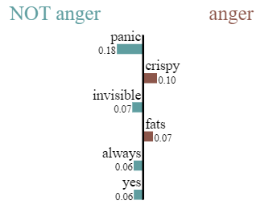
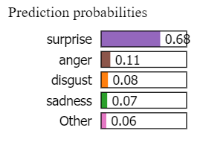
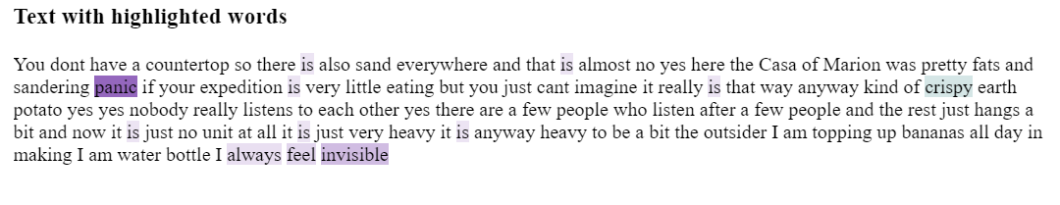
Text Feature Importance LIME Analysis
Error Analysis
True Emotions
sadness
anger

Slide 15

Strengths
Strong
base-model, easy to
scale
Domain
Specific
Data
Good performance on Kaggle data
Translation from Dutch
Limitation
Good at predicting happiness
Subjectivity in ground truth labels
Implicit
and contextual emotion detection
Model trained on sentences, not fragment
Notes:
Rebecca

Slide 16
Future recommendations
More data
Use RobBERT (Pretrained on Dutch data) and use Dutch Datasets
Avoid translation
Notes:
All

Slide 17


